Slide 1
Not for the Love of Money
Creating a local alternative economy
where there is an abundance
of work and resources
to meet the basic needs of everyone.

Slide 2

My Objective

Slide 3

Why do we need a local currency?
$
vs

Slide 4
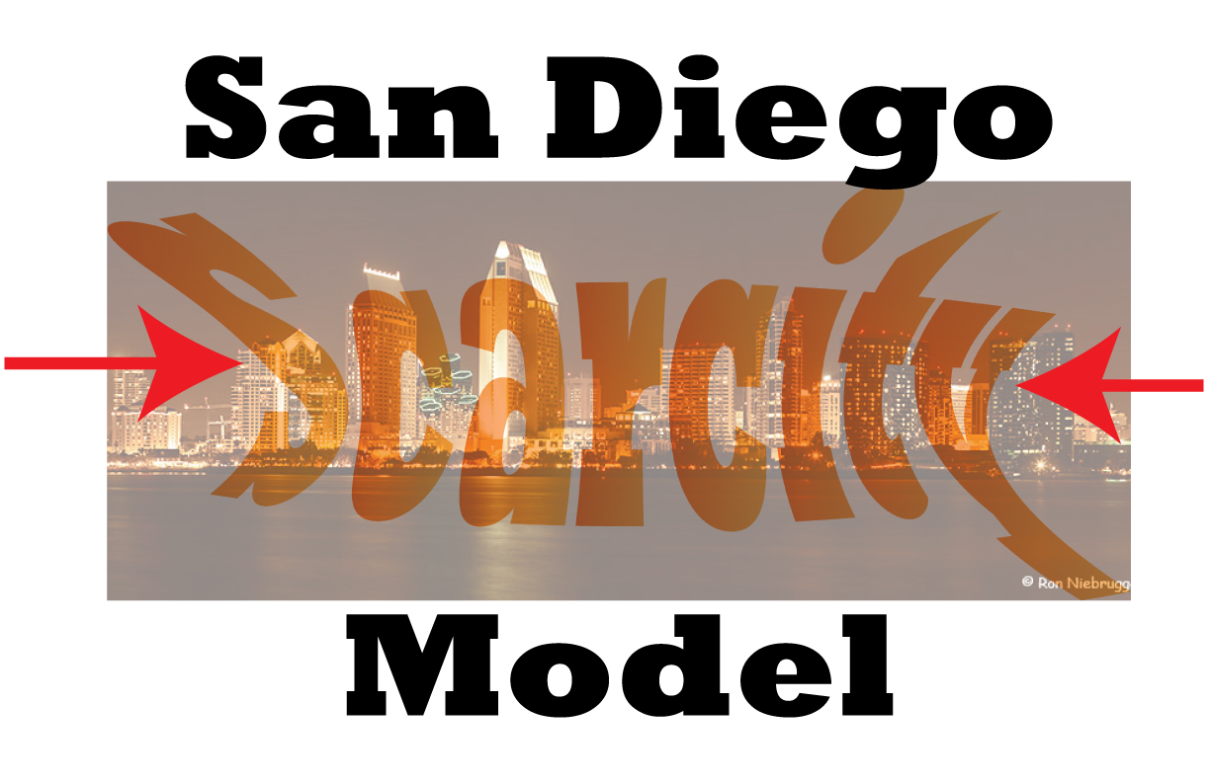
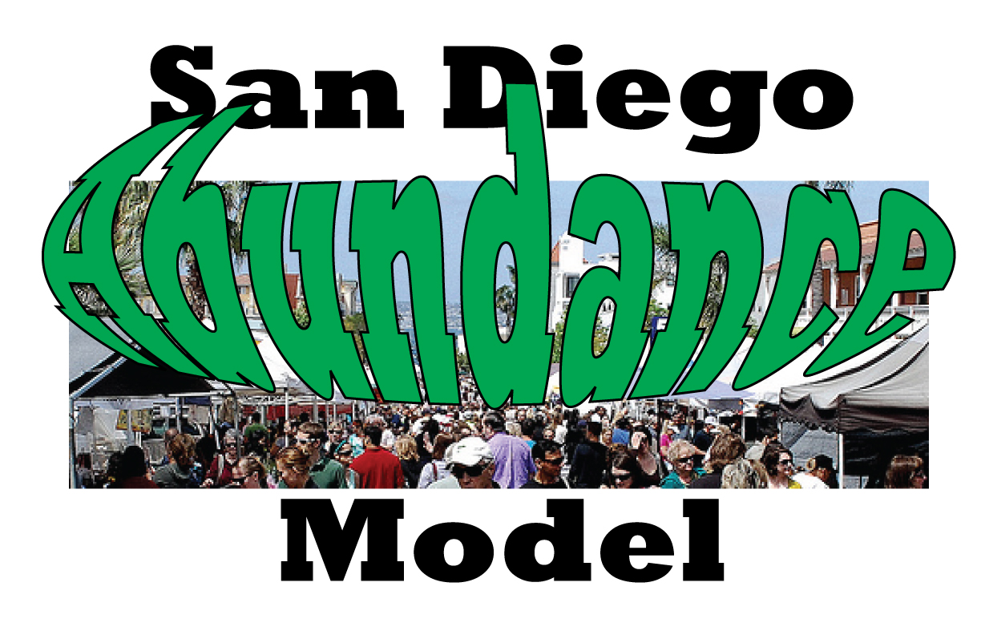
vs
Not enough for everyone

Slide 5
Why does our current monetary system create economic scarcity ?

Slide 6

Because Our Money is Created with Debt
Fractional Reserve Banking
Banks only need to have in reserve, 10% of what they lend.
$10,000
Original Deposit
$9,000
$1,000
Bank can lend 90% of the funds
And only hold 10% in Reserves

Slide 7
Each time they loan money only 10% actually exists
The other 90% is new money
$9,000
New Loan Deposited in Bank
$8,100
$900
Bank can lend 90% of the funds
And only hold 10% in Reserves

Slide 8
Money from Nothin’… actually money from debt
After 90 transactions
the amount available to lend
from an initial deposit of $10,000
is reduced to $1
BUT,
While $9,999 will be held in reserve,
$89,992.38 new money
will be created out of nothing!
Simply by creating debt!

Slide 9
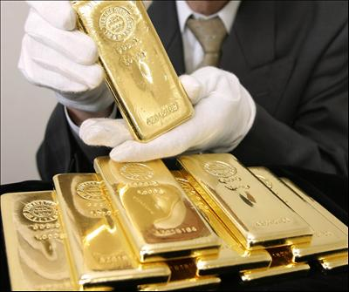
But It Isn’t for Free
The principal amount is created at the time of the loan…
  but money to pay the interest was not created.
Interest-bearing debt grows with the passage of time…
  but in our debt-based system,
  the supply of money to repay
  loans and interest can only be
  expanded by banks making
  additional loans.

Slide 10
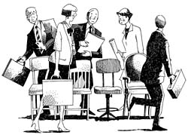
It’s a Game of Musical Chairs
Banks must continually create more debt so there is enough money to pay back their loans with the interest.
Debtors must
compete for a
insufficient supply
of money to repay
their debts, and
some must
eventually default.

Slide 11
The Impossible Debt
Ultimately the rest of society, over generations,
is held responsible for trying to pay the interest part of a collective debt that is impossible to pay because the banks only create the principle, not the interest.

Slide 12
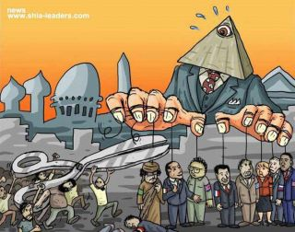
It’s up to us to
create a new & just
economic system
because no one profiting from the current system is going to change it for us

Slide 13

A just economic system requires an entirely different monetary system

Slide 14
“The species that prosper over the long term are not the most brutal & competitive,
but rather those that find a niche in which they meet their needs in ways that simultaneously serve the needs of others
and optimize the life of the whole.”
—David Korten

Slide 15
An Abundance Model requires us to rethink everything!

Slide 16
Business
  - corporations should not be legally required to only act in the interest of shareholders’ profits
Prosperity
  - there should be enough for everyone
Work
  – spend our time making a life instead of just a living

Slide 17
Ownership
  – natural resources, including land, belong to everyone
Cooperation vs. Competition
- when artistic expression and activities that bring us happiness are made into competitions, we lose the simple joys of living.
Value
- when we measure success by monetary wealth and possessions, we lose sight of what really makes us happy.

Slide 18
Capitalism
- Community capitalism nurtures entrepreneurship
Individualism
- no one should expect to get or do anything for free
Money
- money should circulate locally to benefit local interests

Slide 19
A Local Currency
A local currency eliminates the scarcity of money by providing a means to effectively & efficiently facilitate the reciprocal exchange of goods & services
Money is simply a holder of value
It is perfectly legal to institute your own local currency to supplement or replace the national fiat currency
No interest is involved on either side of the transaction

Slide 20
Alternative Exchange Systems
There have been many attempts by individuals, organizations and local governments to develop an alternative to the national currency system. Some have come about spontaneously as communities sought ways to survive economic depressions while others have been carefully planned and modified for various applications.

Slide 21
Discounts / Incentives
– Coupons, Membership/Loyalty Card,
Trading Stamps, Rebate Certificates
A well-designed discount or coupon campaign can boost sales but unlike when a business accepts local currency, the coupon has no value to the business after the customer turns it in. The cycle of it as a currency is limited to that one transaction. When competing businesses adopt the coupon strategy, its effectiveness in increasing sales diminishes.

Slide 22
Cash Substitutes
– Gift Certificates, Travelers Checks, Casino Chips, Deli Dollars, Farm Preserve Notes, Subway Tokens
These currencies are purchased for cash and do not increase the local money supply but can bolster the local economy if they must be spent in the community. Sometimes cash paid for the substitute currency is less than the face value, making them a popular fundraising medium. Gift certificates usually do not circulate. Traveler’s checks are more widely accepted and usually cost more than the face value.

Slide 23
Barter Exchanges
– Itex, WIR Bank, Barter Banc, Barter Systems
Bartering is a medium in which goods or services are directly exchanged for other goods and/or services without the use of money and usually exists parallel to monetary systems. Barter usually replaces money as the method of exchange in times of monetary crisis, and is common in the present, usually used within the Internet on websites such as Craigslist.

Slide 24
Conversion of Official $ to Community Script
– Toronto Dollars, BerkShares, Liberty Dollars, Phoenix Dollars, UCSD Triton Dollars
Businesses that accept community currency usually redeem this script for less than the face value, the difference going to cover cost of managing the system and to support local charities. It provides goodwill for the business, attracts new customers and builds a loyalty customer base. These systems do not solve the scarcity of money issue.

Slide 25
Time Exchange
Ithaca Hours, 4th Corner Exchange,
Crom Alternative Money
Time Banking is reciprocal service exchange which uses units of time as currency. A Time Bank, also known as a Service Exchange, is a community which practices time banking. The unit is an hour's worth of any person's labor, known as a Time Dollar. Time banking began in the U.S. in the early 1980's. Today 26 countries have active Time Banks. There are 53 officially recognized Time Banks in the U.S.

Slide 26
Web-based Trading
– eBay, Craigslist, BarterQuest,
BarterBart, U-Exchange

Slide 27
Peer-to-Peer Cryptocurrency
– Bitcoin, Litecoin, Dogecoin
Bitcoin is digital money used for secure and instant transfer of value anywhere in the world. It is not controlled or issued by any bank or government - instead it is an open network which can be sent from user to user on the peer-to-peer bitcoin network. Similar to stocks or property, bitcoin’s value is determined by buying and selling in the open market, based on the number of people who want to buy or sell it at a given moment. 3/29/2919: 1 Bitcoin = $4,037.50 US

Slide 28
Mutual Credit
– LETS, Calgary Dollars
Money is issued by the transaction when the seller’s account is credited and the buyer’s is debited.

Slide 29
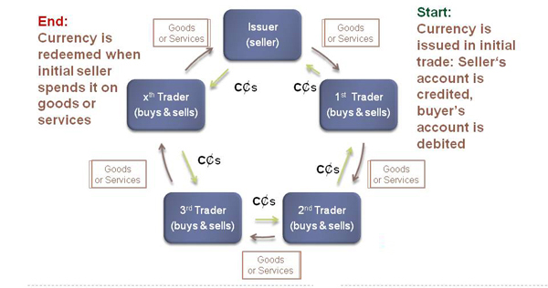
A Mutual Credit System
Notes:
17

Slide 30
When Money is Created by Transactions
No interest is involved on either side of the transaction.
Mutual credit allows a buyer to purchase goods or services from one seller and pay for that purchase by providing goods and services to another buyer or multiple buyers in the system.
Mutual credit is self-regulating, expanding and contracting as needed.

Slide 31
A proposed local currency
  - A value-based mutual credit currency issued by traders to facilitate their trade.
  Electronic transactions-log trades via Internet
  using swipe card reader, computers and phone app.
  Measure of value-start at equivalence to US$ and adjusted monthly to the Consumer Price Index (CPI)
  Debit limits based on length of membership, reputation ratings (as on eBay) and transactions in prior 3 months (gauging ability to pay)
  Cannot be cashed in for US$ (with some exceptions)
Notes:
18

Slide 32
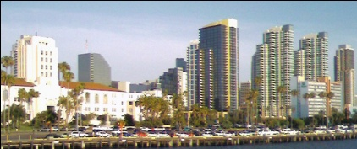
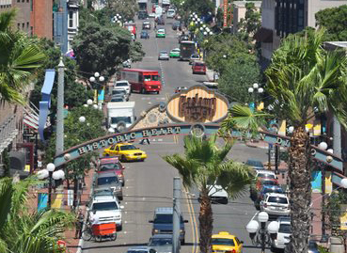

Clearing
Exchange
Common Credits Website
Common
Freelance
Agency
Common
Property
Members
City agrees to accept business fees in CCs
City & local businesses hire members through Common Freelance Agency - pay agency fee and taxes in US$ and payroll in CCs
Common Market
(Traders)
City of San Diego
Lease City property & pay in CCs. Members pay rent in CCs
Members buy goods & services from Member Traders with CCs
How an
Alternate Economy
could work
within our
current system
Members sell & purchase goods & services in CCs & taxes in US$
Clearing Exchange charges Traders 1% fee for administration costs
Provides loans and guidance for small business start-ups using CCs
Common Credits - (CCs) is all digital trading through website and swipe cards

Slide 33
Common Credits Membership
    Open to anyone, although designed to initially appeal to the most needy
    Members agree to trade in part or whole in Common Credits
    Member agrees to balance their account if they decide to leave the system
Notes:
13

Slide 34
The Common Freelance Agency
-facilitates paying for and providing work & services with CCs while meeting IRS tax requirements:
    Services the organization buys with CCs
    Services exchanged between Member Traders
    Work that San Diego City buys with CCs
    Work that outside businesses buy with CCs and/or US dollars
Notes:
31

Slide 35
The Common Freelance Agency
Allows freelance traders to meet their tax requirements with US dollars
Acts as an exchange
    Businesses and visitors outside the system can exchange US dollars for CCs to use in the Common Market and to hire member professionals in the Common Freelance Agency
    CCs cannot be exchanged for US$ except to facilitate member traders meeting their tax obligations
Notes:
32

Slide 36
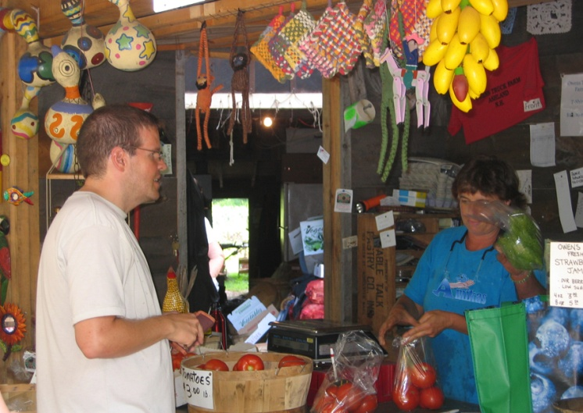
The Common Market
– a real incubator for entrepreneurs
Micro loans – no-interest loans in CCs and US$ (as needed) for neighborhood enterprise start-ups
Business mentoring, counseling and education
Provides Web-based business tools
Shops and stands available for rent in CCs.
Notes:
33

Slide 37
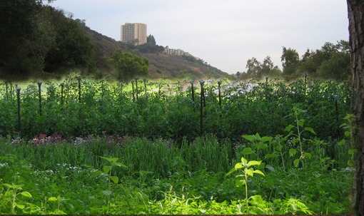
The Common Farm
Organic, bioneering, hydroponics, permaculture
Run by Common Freelance Agency Professionals
Grow food to sell to Members for CCs
Livestock - chickens, dairy cows
Greenhouse, sheds/barns
Farm equipment
Outside, local organic farmers
can become Member traders
buy agreeing to accept CCs.
Notes:
34

Slide 38
Common Health Care
–everyone has a right to health care
Self-funded health insurance provided for all members for care required outside of member providers
– for now we have to work within the insurance-based system
Member health care providers accept payment in CCs
- can be members or outside practitioners who agree to take payment in CCs
  Alternative health options available
  – profit motive is removed from diagnosis and treatment.
Notes:
35

Slide 39
Common Housing
–everyone has a right to housing
City agrees to lease city-owned housing to Common Community for combination of CCs & US$
Members can rent housing units with combination of CCs & US$
Alternative health options available
– profit motive is removed from diagnosis and treatment.
Notes:
35

Slide 40
Benefits to Region
  Puts needed currency into local economy
  People can work with dignity and earn a living wage
  If City or County will accept CCs for (full or partial) payment of fees, permits, taxes, then more CCs would be available for the government to spend on Member’s services through the Common Freelance Agency.
  Public image bonanza
Notes:
40

Slide 41
Benefits to Local Business
  Local businesses are suffering from
  a deficiency of money in circulation
  – Common Credits add to the
  availability of local money.
  Common Credits are not based on debt
  – people are freer to spend,
  – gets inventory moving
  Only need to accept a percentage in CCs
    – much like a discount coupon except that they can spend the CCs (they can’t spend a coupon)
    – Businesses with high value added or excess capacity can accept a higher % of sales price in CCs
Notes:
42

Slide 42
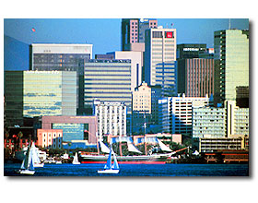
Benefits to Local Economy
  Creates excitement in community – builds goodwill
  Business suffers when people are living on sidewalks outside shops
  Poverty and homelessness hurt tourism
  – bad for city image, sense of safety,
  who wants to see people suffering while
  you are enjoying yourself
  Businesses can use CCs to trade with
  other businesses that accept CCs and
  Member Traders
Notes:
41

Slide 43
Getting US$ into the System
US dollars are needed for taxes, insurance and equipment and goods that cannot be supplied by Member traders
Supporters
  Individuals or organizations can contribute US dollars to Common Community in exchange for CCs
  This is not tax deductible, but is a way for like-minded individuals or organizations to support the goals of the Common Community and to extend the reach of Common Credits by spending them in the community or hiring Member traders
Notes:
45

Slide 44
Getting US$ into the System
When outside businesses or the city or county government hire member traders through the Common Freelance Agency, they must pay a percentage in US$ equivalent to the estimated income and self-employment tax the freelancer will be obligated to pay.
When freelancers must pay their taxes, they can trade in their CCs for US dollars for the amount due – this is the only time CCs can be exchanged for US dollars
Outside parties who wish to hire Member Traders or Professionals can exchange their US$ for CCs through the Common Freelance Agency
Visitors who wish to shop in the Common Market must exchange US dollars for CCs
Notes:
46

Slide 45
Legal Considerations
Permits and Zoning Regulations
The City hiring Common Freelance Professionals could conflict with union contracts
Sales Taxes – if paid with CCs they need to be converted into US$
Insurance (liability, workman’s comp)
Ownership
Formation of Non-profit Organization
Notes:
47

Slide 46
Let’s Get Started
Whatever you can do,
or dream you can,
begin it.
Boldness has genius, power
and magic in it.
--Goethe

